Slide 1
Behavioral Analytics of fitness tracker data
Understanding the relationship between activity, sleep, sedentary behavior, and lifestyle patterns.
Tools: Python · SQL · Power BI
By: Taruna Miglani

Slide 2
Executive Insights:
Daily physical activity shows a strong linear relationship with calorie expenditure, validating steps as a proxy for energy output.
Activity behavior is time-clustered, with peaks occurring in late afternoon and evening, suggesting lifestyle-driven exercise routines.
Sedentary behavior demonstrates negative behavioral association with sleep duration, indicating potential lifestyle imbalance.
Sleep behavior appears weakly correlated with physical activity, implying sleep quality depends on broader lifestyle variables.

Slide 3
Dataset Overview
Key Scale Matrics:
22,099 hourly
observations
35 daily user records
Dataset | Description
Daily Activity | Steps, calories, activity minutes
Hourly Steps | Steps recorded per hour
Hourly Calories | Calories burned hourly
Hourly Intensity | Activity intensity levels
Sleep Dataset | Sleep duration and time in bed
Weight Dataset | Weight and BMI records

Slide 4
Data preparation & eda
Python was used to :
Datasets were then integrated and exported to SQL for structured Querying before visualisation in Power BI
Remove duplicate records, Convert timestamp formats and Derived measures : Sleep efficiency , Hours asleep, Hours in bed.

Slide 5
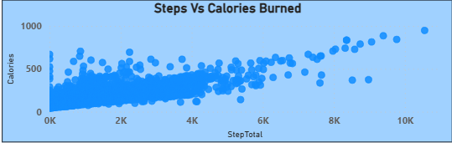
Activity vs Energy expenditure
Analytical Insight
The scatter distribution shows a clear positive slope, confirming a strong linear relationship between daily step counts and calorie expenditure.
However, variance increases at higher step counts, suggesting that users burning similar calories may exhibit different step patterns due to activity intensity differences.
Implication
Calories are influenced not only by step volume but also by movement intensity and workout activity.

Slide 6
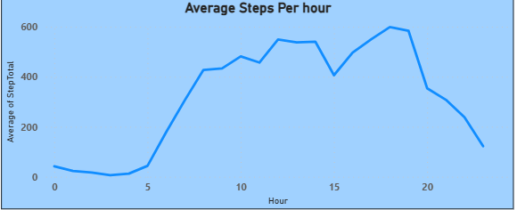
Temporal Activity behaviour
Analytical Insight
The Activity curve shows two behavioural clusters :
Moderate Activity during commuting hours
A significant peak in late afternoon and evening
Interpretation : This suggests user tend to engage in intentional exercise after work hours , rather than throughout the day.
Implication : Fitness engagement tools should target evening engagement windows.

Slide 7
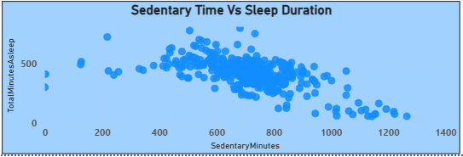
Sedentary behaviour vs sleep
While the relationship is not strictly linear, the chart shows clusters of lower sleep duration among users with high sedentary time.
Extended sedentary behavior may correlate with irregular daily routines or poor sleep patterns.
Implication : Reducing sedentary time could improve lifestyle balance.

Slide 8
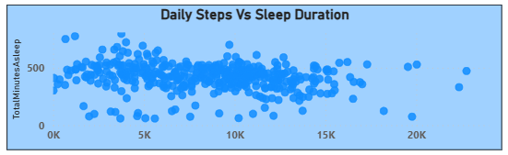
Activity vs sleep duration
The scatter distribution shows weak correlation between steps and sleep duration, indicating that increased activity does not necessarily translate to longer sleep.
Sleep behavior is influenced by multiple variables such as lifestyle habits, stress, and sedentary behavior.
Implication : Physical activity alone is insufficient to predict sleep quality.

Slide 9
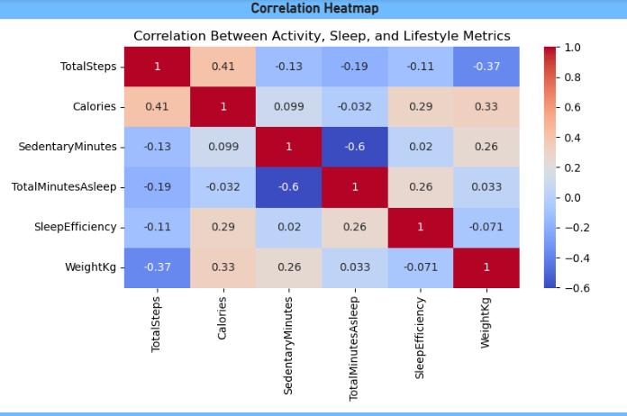
Correlation matrix
Strong correlation between steps and calories.
Moderate correlation between activity intensity and calories
Weak correlations between sleep metrics and activity metrics .
Implications : Lifestyle behavior is multidimensional, where sleep patterns cannot be explained by activity metrics alone.

Slide 10
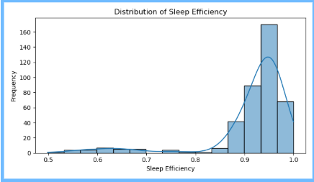
Sleep efficiency distribution
Most users cluster around high sleep efficiency levels, but the distribution tail reveals a smaller subset with significantly lower sleep efficiency.
While average sleep patterns appear healthy, a minority of users may experience poor sleep quality, which could indicate behavioral or lifestyle issues.

Slide 11
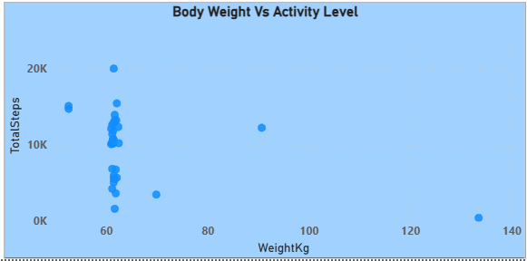
Weight vs activity
The scatter plot demonstrates that users with nearly identical body weight can exhibit drastically different activity levels, highlighting that behavioral patterns — rather than physical attributes — are the primary drivers of daily movement.

Slide 12
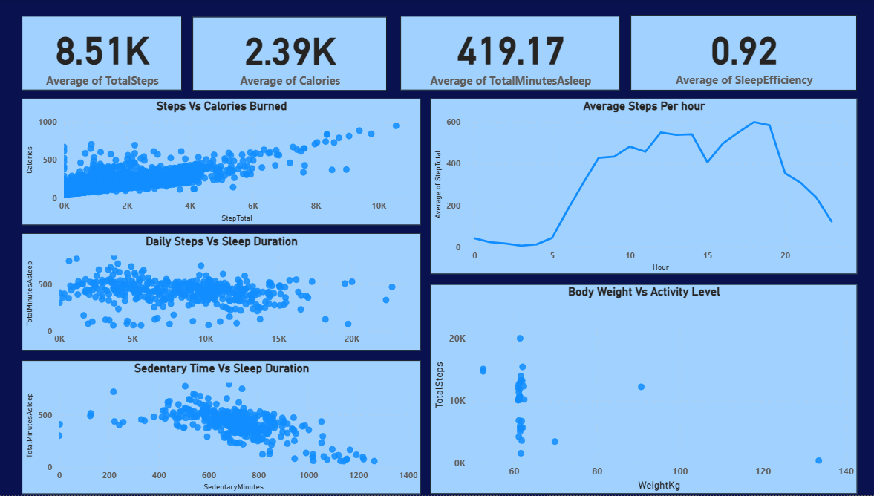

Slide 13
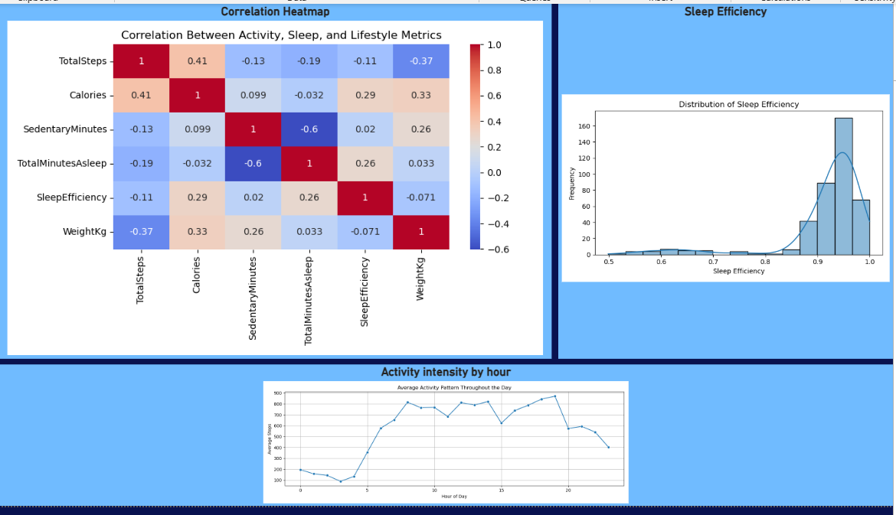

Slide 14
Thankyou
Key Takeaways:
Physical activity strongly predicts calorie expenditure.
User activity peaks during evening hours.
Sedentary behavior may negatively affect sleep duration.
Sleep behavior depends on multiple lifestyle variables.

